Slide 1
Brick BREAKER
Presented by :
Vivek Shukla

Slide 2
Contents
Introduction
1) Guidelines
Data Flow Diagram
Logic and memory :
1) Storing bricks
2) Detect Collisions
3) Ball Trajectory

Slide 3

Introduction

Slide 4
Guidelines
We made an interactive game based upon the classic game brick breaker. The object of brick breaker is to break the bricks that are distributed around the top of the game screen. The bricks are broken after coming in contact with a ball that bounces around the screen. At the bottom is a paddle that in the classic game moves based on user input. The user has to make sure the ball bounces off
the paddle without going off the bottom of the screen.

Slide 5
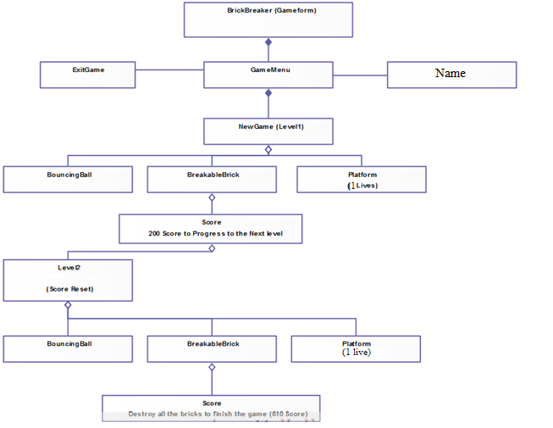
DATA FLOW DIAGRAM

Slide 6
Logic and Memory
The logic and memory are the most basic implementation of the game consisting of
storing bricks,
2) detecting collisions, and
3) determining the trajectory for the ball.

Slide 7
1) Storing Bricks
The brick breaker game needed a way to conveniently store the existence, style, and placement of all the bricks. Since this was implemented in programming languages it made the most sense to have in memory a fixed number of brick memory
placeholders. The brick memory placeholders-essentially a 2D array - simply held all the
information needed to describe a brick and importantly whether the brick should “exist” or not.

Slide 8
2) Detect Collisions
One challenging step was to detect and properly identify the collisions in the game. There were four sides of the gameplay area, a paddle that tilted, and 35 bricks that all could have come into contact with the circular ball. The bricks each had four sidesand four corners.

Slide 9
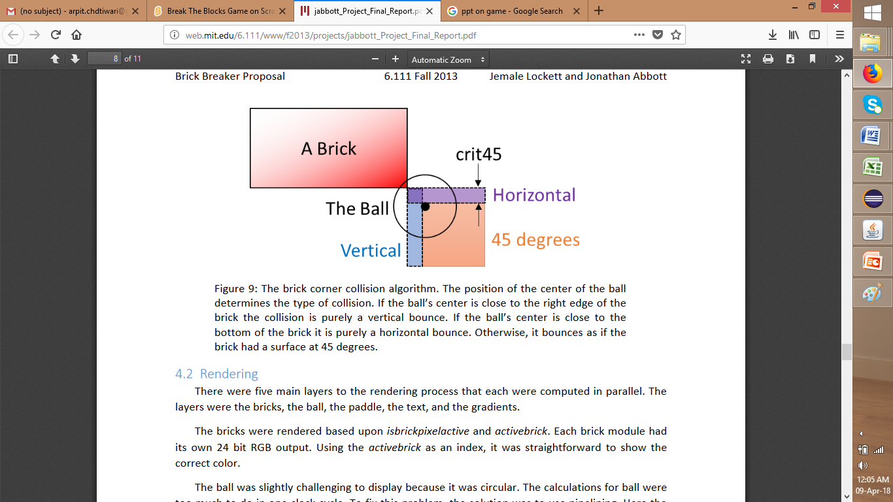
BallTrejectory
After potential collisions had been detected, the next step
was to determine the trajectory of the ball.
The x and y positions for the ball were computed separately
in parallel.

Slide 10
BallTrejectory(II)
The algorithm worked as follows:
1) If there were a wall collision, the ball would be placed adjacent to the wall and the velocity would change direction.
2) Else, if there were a brick collision, the ball would have to bounce appropriately. Bouncing off the sides of the brick was fairly trivial, but corners were much trickier. A simple approximation was used to either treat the collision as a side collision or a 45 degree angle collision.

Slide 11
BallTrejectory(III)
3) Else, if there were a paddle collision, the ball would have its velocity directed upward and the paddle’s velocity would be scaled and added to the ball.
4) Else, the ball would be in free space and acted under a constant pull of gravity.

